Slide 1

AstroScope – Interactive Exoplanet Detection Platform
NASA Space Apps Challenge 2025
Celestial V

Slide 2

AstroScope – Interactive Exoplanet Detection Platform
NASA Space Apps Challenge 2025
AstroScope is a comprehensive platform for exploring, analyzing, and accurately predicting exoplanets using advanced machine learning and interactive visualization techniques.

Slide 3

The Challenge: Navigating Astronomical Data
Data Deluge
Signal vs. Noise
Modern astronomical missions like Kepler and TESS generate millions of high-resolution observations annually, surpassing manual analysis capacity.
Identifying genuine exoplanet transit signatures is extremely challenging due to high noise levels, instrumental errors, and common stellar false positives.
The AstroScope Solution
We combine robust machine learning models, predictive accuracy, and user-friendly data visualization to deliver accurate, confirmed exoplanet detection.

Slide 4



Core Technology Stack
Python Ecosystem
Machine Learning Engine
Interactive Dashboard
Pandas, NumPy for high-performance data manipulation.
A high-performing Random Forest Classifier is employed, combined with Permutation Feature Importance for model interpretability.
Streamlit provides the framework for a fast, responsive, and interactive web application for data exploration and prediction visualization.
Scikit-learn for robust ML model construction.
Matplotlib/Seaborn for exploratory data analysis.

Slide 5


Leveraging the Kepler Exoplanet Candidate Data
Our predictive model is trained and validated using a subset of the official
NASA Kepler Exoplanet Candidate Dataset, comprising approximately 8,000–
10,000 distinct candidates.
Target Variable: Confirmed Exoplanet (Binary: 0/1)
Key Numeric Features: Orbital Period,
Transit Time, Kepler Magnitude.
Key Boolean Flags: Not Transit-Like Event, Stellar Eclipse, Centroid Offset, Ephemeris Contamination.
Feature engineering and interpretation of these specialized.
astronomical indicators are crucial for maximizing model accuracy
and reducing false positives

Slide 6





Methodology: From Data to Prediction
Evaluation & Visualization
Deployment
Data Processing
Model Training
Data Preprocessing
Classifier Training
Normalization of all numeric features and handling of
missing values to ensure model stability and optimal
performance.
Training the Random Forest model using stratified
splitting and class weighting to handle the inherent
imbalance in confirmed exoplanet data.
Model Evaluation
Rigorous evaluation using metrics like AUC, precision, and
recall; feature importance visualization for model validation.
Interactive Deployment
Deployment of the trained model via a Streamlit interface, allowing real-time interaction and prediction on new or custom candidate data.

Slide 7
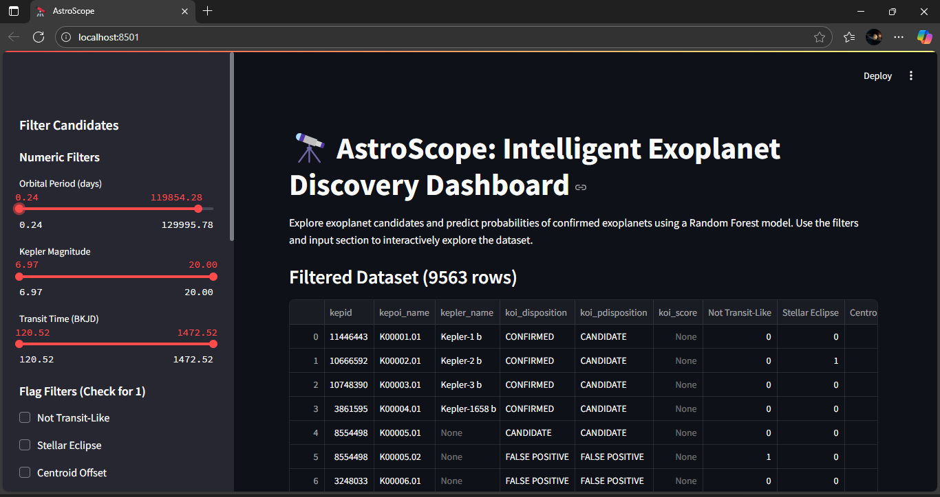
Interactive Detection Dashboard
The Streamlit application allows users—from researchers to students—to dynamically analyze model predictions, explore feature distributions, and gain insight into the detection process.

Slide 8
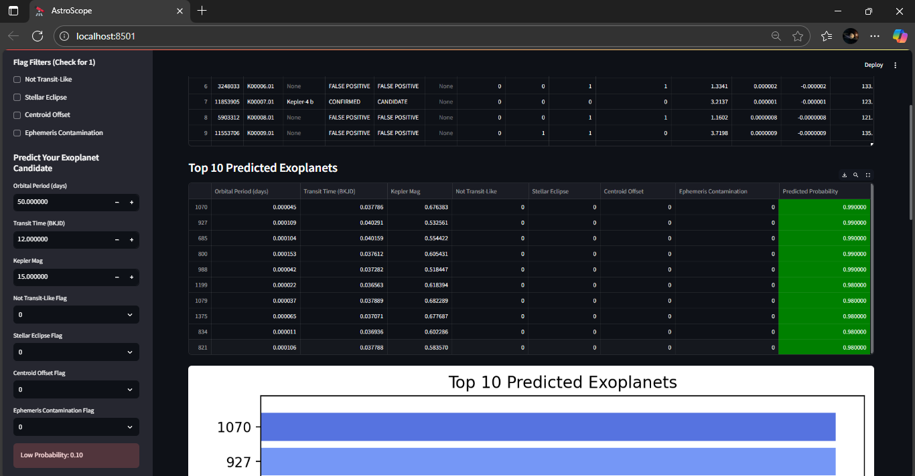
Interactive Detection Dashboard
Users can upload new transit data or select a candidate from the existing catalog to receive instant, interpretable exoplanet predictions.

Slide 9









Impact & Future Trajectory
Reliable Predictions
Education & Outreach
Scalable Research
AstroScope provides accurate and interpretable predictions, significantly streamlining the initial screening phase for exoplanet candidates.
The interactive nature makes complex data science and astrophysics accessible for educational purposes and broader public engagement.
By automating the detection process, AstroScope enables researchers to focus their valuable time on novel discoveries rather than manual triage.
Future Enhancements
Advanced ML Models
Cloud Deployment
Enhanced Visualizations
Integration of Gradient Boosting or sophisticated Neural Network architectures to further enhance prediction accuracy.
Full cloud hosting to ensure global, 24/7 accessibility and real-time processing capabilities for new data streams.
Development of advanced visual elements, including 3D orbital simulations and feature heatmaps.

Slide 10

Thank You
The Celestial Voyagers Team appreciates your time
and consideration.
AstroScope – Mapping the Cosmos, One Exoplanet at a Time.

